Slide 1
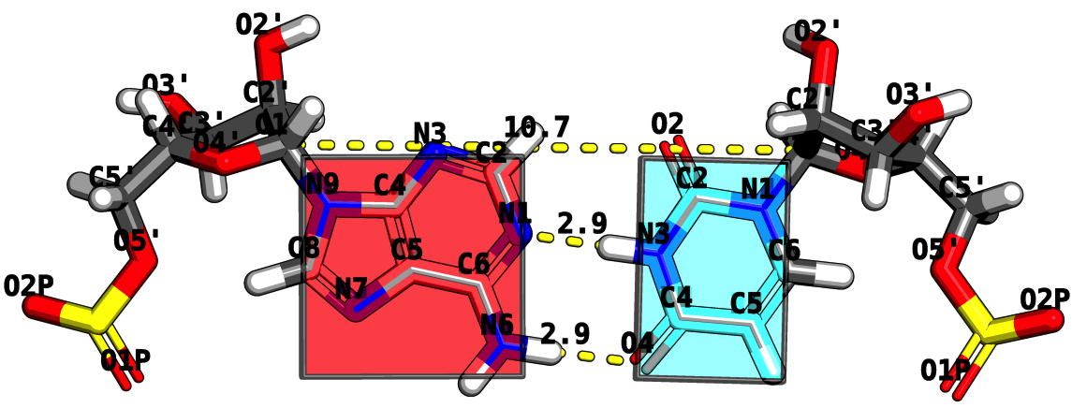
RNA Structure Analysis via the Rigid Block Model
Mauricio Esguerra
October 5th, 2010
Chemistry and Chemical Biology Department
Rutgers, The State University of New Jersey

Slide 2
Program
Opening Act
THE CHALLENGE: How does RNA fold?
Act I
RNA BASE STEPS: Dinucleotide step classification using single-stranded base step parameters.
Act II.
RNA BASE PAIRS: Base pairs in RNA helical regions.
Act III
RNA BASE PAIR STEPS: From local to global properties in RNA with the aid of rigid-blocks.
Act IV
RNA STRUCTURAL MOTIFS: RNA structural motifs identification using rigid-blocks.
Finale
Notes:
Change it to Act I, Act II, etc. → Intermezzo.

Slide 3
Opening ACT
THE CHALLENGE:
How does RNA fold?
Is this an easy or hard problem?

Slide 4
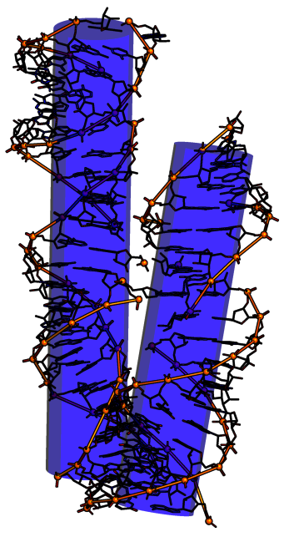
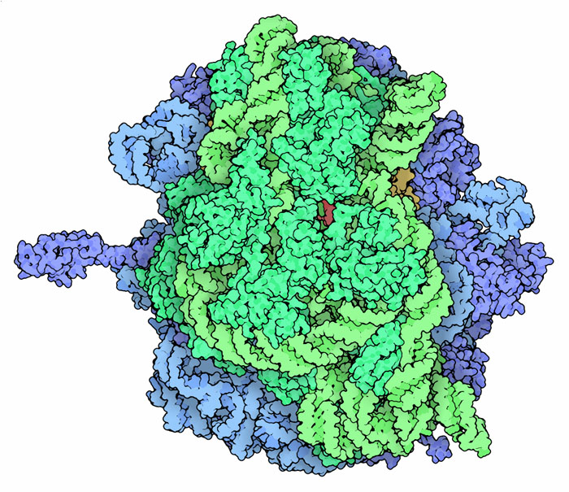
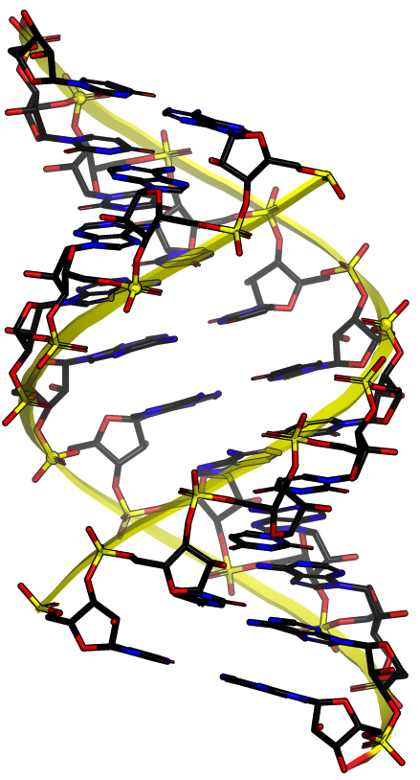
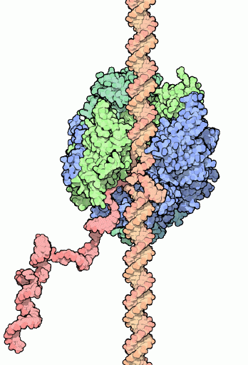
CHALLENGE What is RNA? A structure that can give you a Nobel prize or not.
Ribosome, aka rRNA
Protein factory
2009 Nobel
Ribozymes
1989 Nobel
RNA Polymerase
mRNA factory
2006 Nobel
A-RNA
No Nobel
Notes:
A-RNA 1956 Alex Rich
Tetrahymena themophila self splicing sequences. Sidney Altman and Tom Cech
RNA polymerase. Rogerd D. Kornberg
Ribosome. Ada Yonath, Tom Steitz, Venkatraman Ramakrishnan

Slide 5
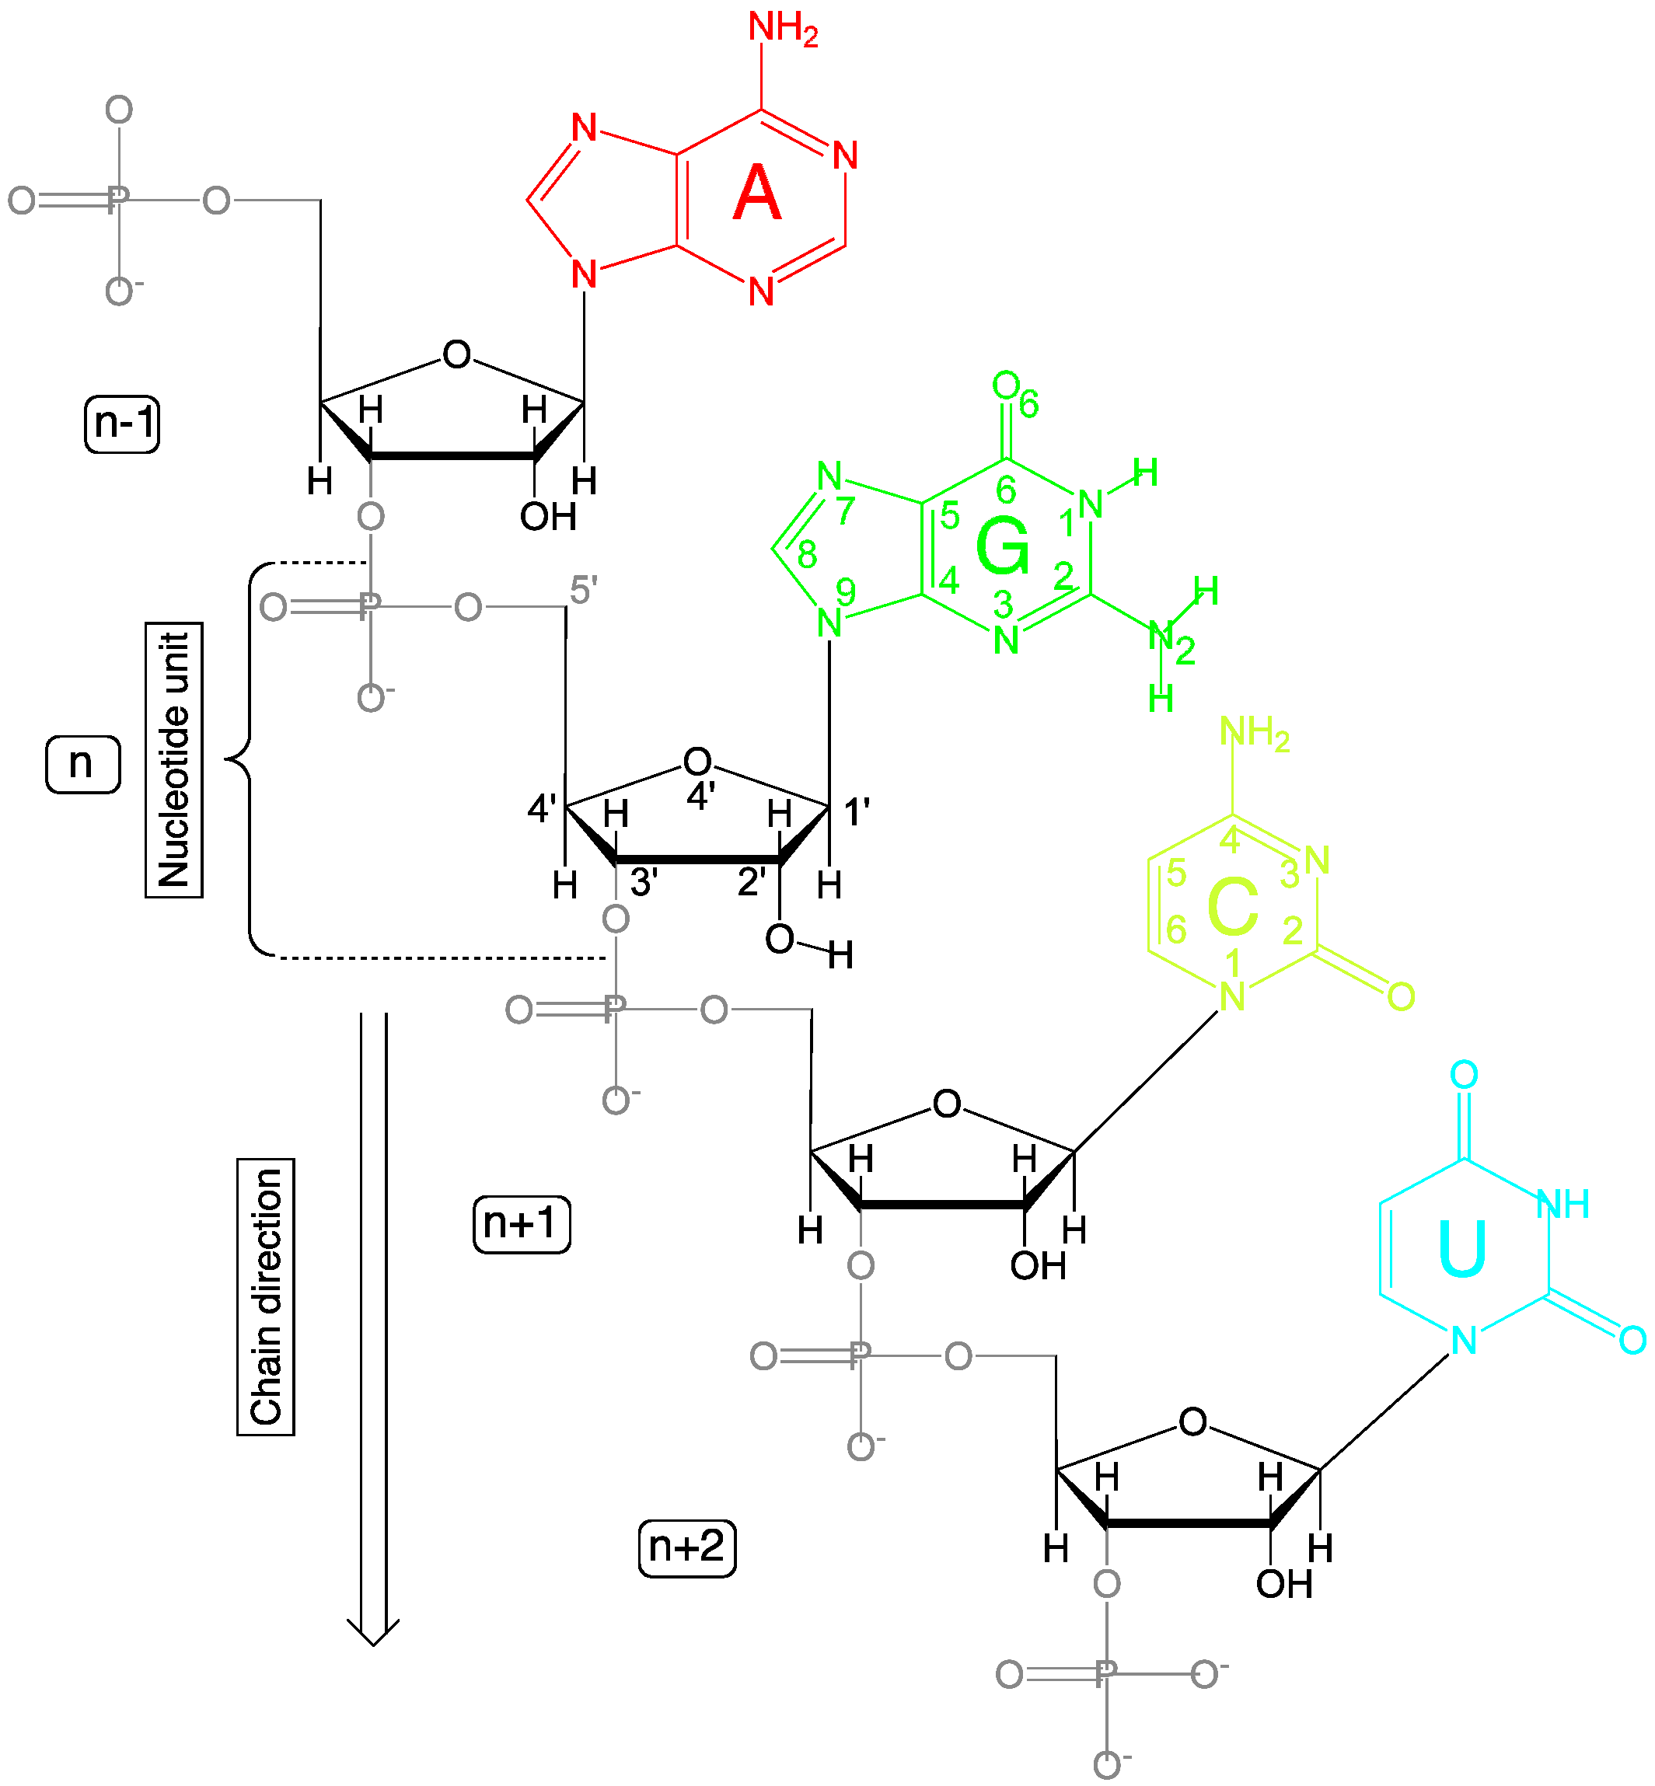
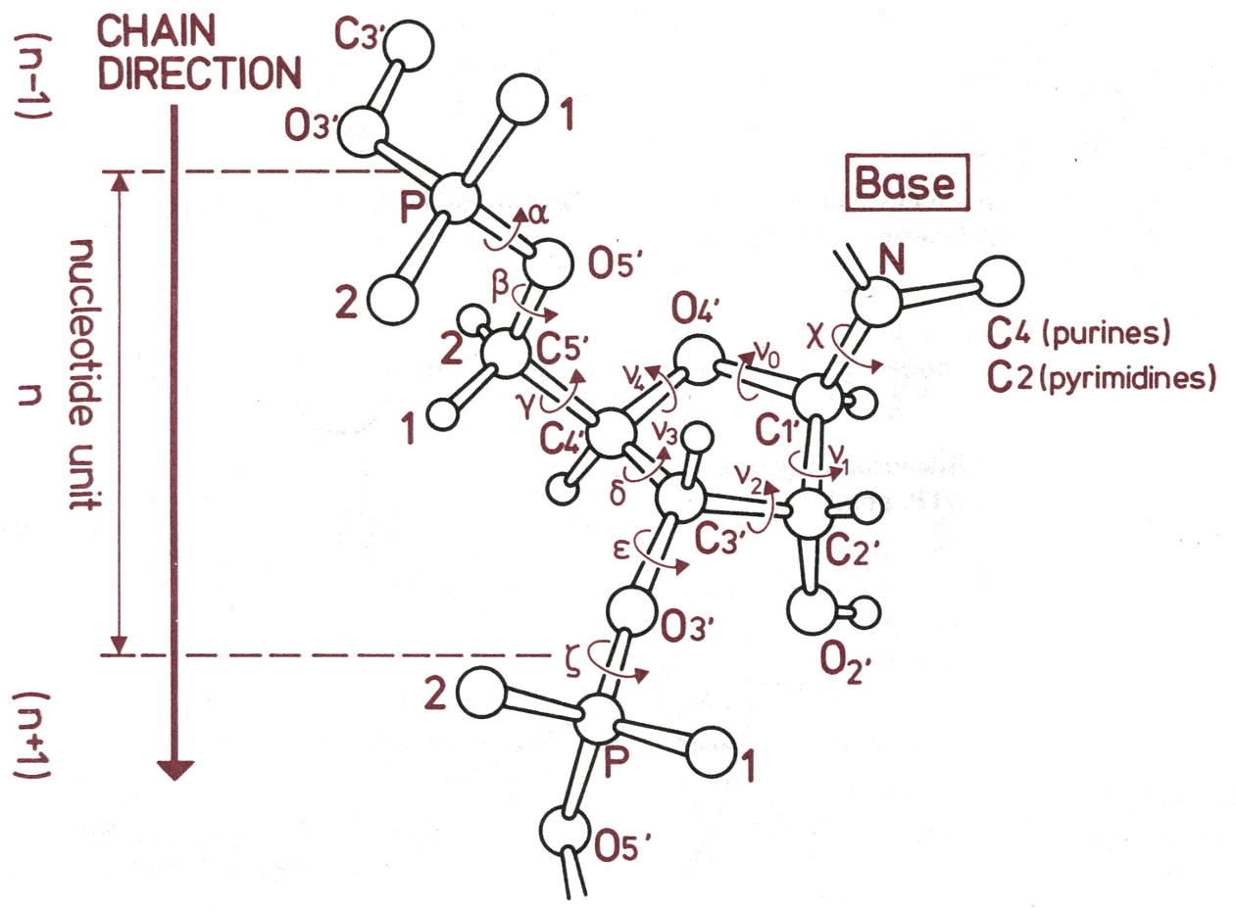
CHALLENGE RNA is composed of units (nucleotides) that have a base, a sugar (ribose), and a phosphate group.
6 Nucleic acid torsion angles.
1 Glycosidic torsion angle.

Slide 6
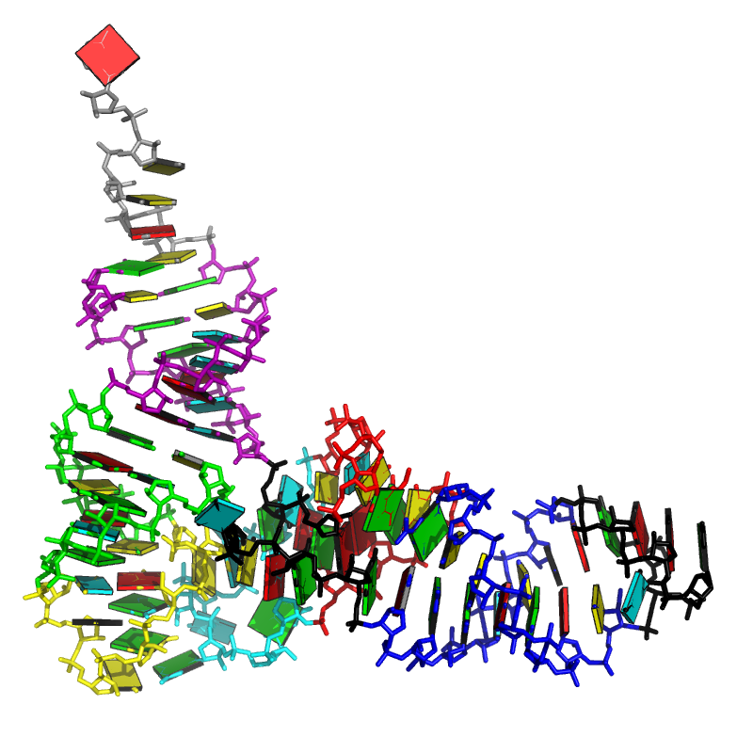
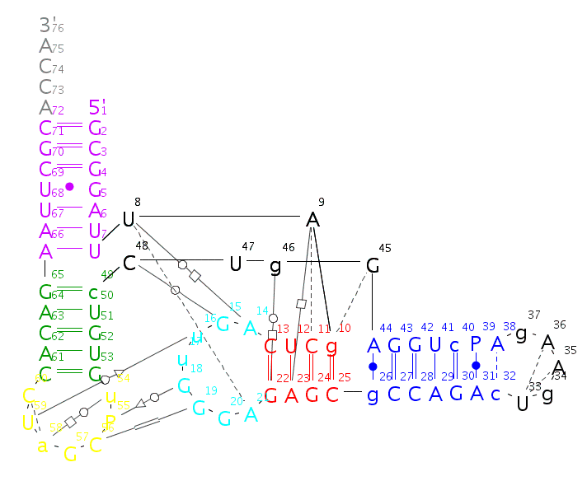
CHALLENGE How does the RNA polymer fold?
Primary
GCGGAUUUAGCUCAGUUGGGAGAGCGCCAGACUGAAGAUCUGGAGGUCCUGUGUUCGAUCCACAGAAUUCGCACCA
Secondary
Tertiary

Slide 7
Add picture of Leontis-Westhof
Add picture of pseudo-bonds nabla and theta.

Slide 8
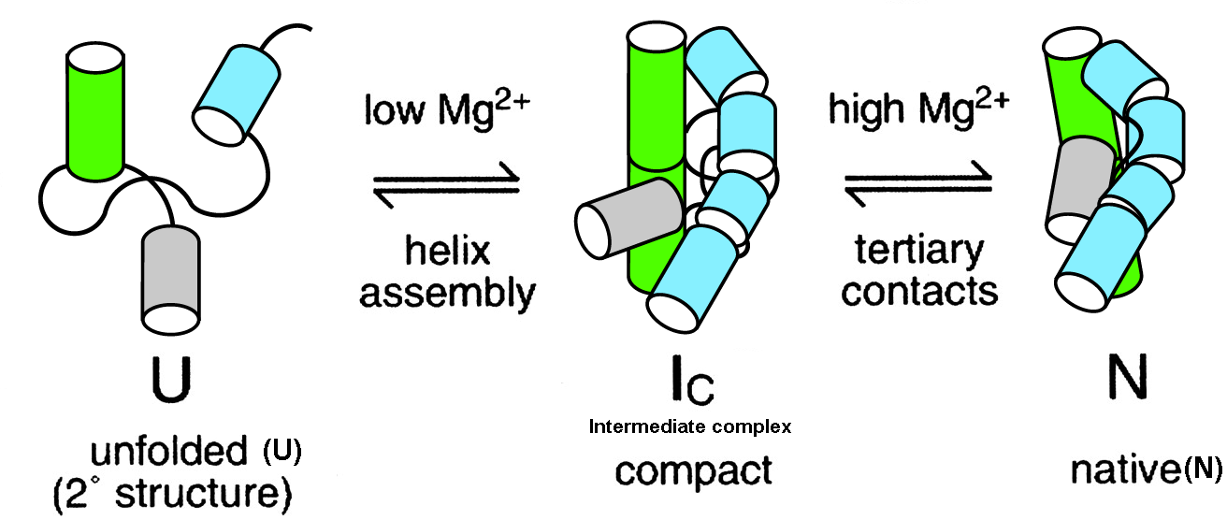
CHALLENGE Is RNA folding a hard or easy problem to solve? After all, the RNA alphabet has only 4 letters.
No hydrophobic surface burial.
Polyanionic sugar-phosphate backbone.
Secondary and tertiary separated by Mg2+ addition.
How do RNA structural properties influence RNA folding?
How are helical regions put together?
Notes:
Too long.
Have the CHALLENGE IN ALL TO CONNECT TO OUTLINE!
Look to see if

Slide 9
CHALLENGE Usual ways to classify RNA conformations and an unexplored one -- the rigid-body perspective --.
The atom-based perspective
Comparison of backbone atom positions.
Comparison from set of backbone, sugar, base, atom positions.
The bond-based perspective
Covalent bonds – backbone + glycosidic torsions.
Pseudo-bonds η and θ.
Hydrogen bonds forming in edge boundaries (Watson-Crick, Sugar, and Hoogsten).
The rigid-body-based perspective
Base-pair parameters.
Base-pair (base) step parameters.

Slide 10
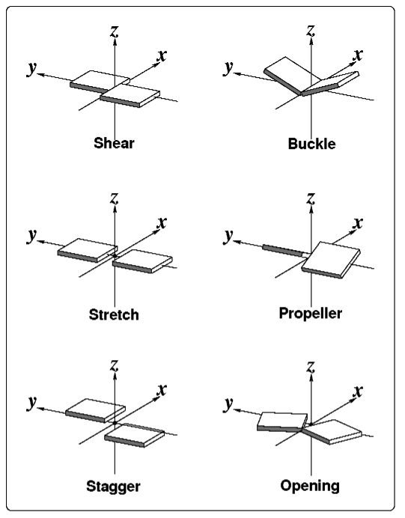
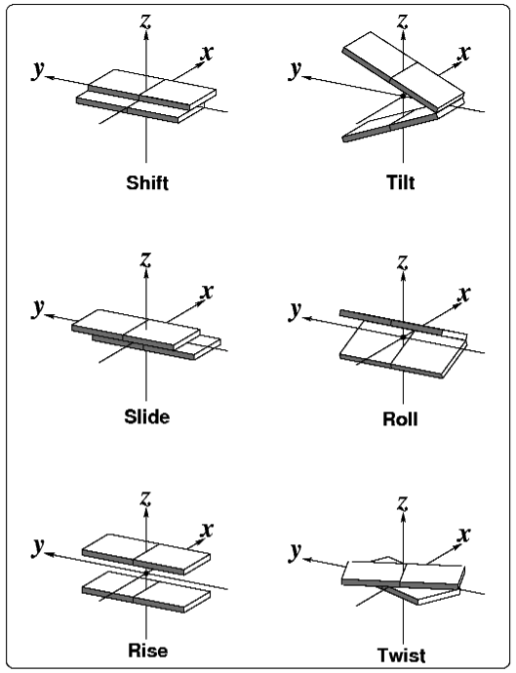
CHALLENGE The rigid-body perspective: Nucleic acid bases and base-pairs represented as blocks.
Base-pair parameters
Base-pair-step parameters

Slide 11
ACT I
Dinucleotide step classification using single-stranded base step parameters
Notes:
Look at what is before ACT, to give it a name as motivation.

Slide 12
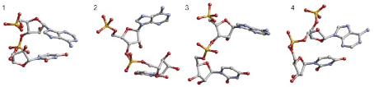
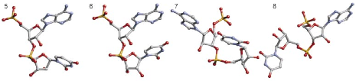
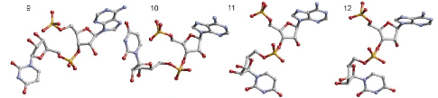
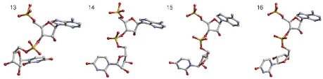
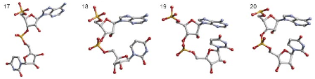
BASE STEPS 18 non-A-RNA, AII-RNA, and canonical A-RNA conformers kindly provided by Berman and collaborators.
Make numbers bigger
Non-ARNA steps in different area
Schneider et al. (2004) NAR, 32, 1667-1677.
AII-RNA
A-RNA
Notes:
Schneider et al. structures with the original numbering. Don’t forget to write kindly provided by.
Say that from distribution of torsion angles instead than from torsion angle alone, which would be interpreted as continuous function.

Slide 13
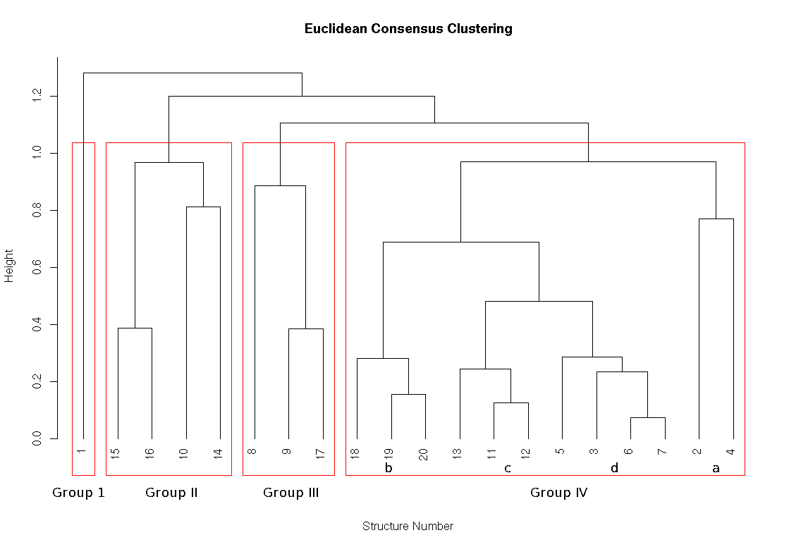
Explain Clustering techniques.
Use both pictures in appendix
Meaning the hierarchical picture
And the scoring methods

Slide 14
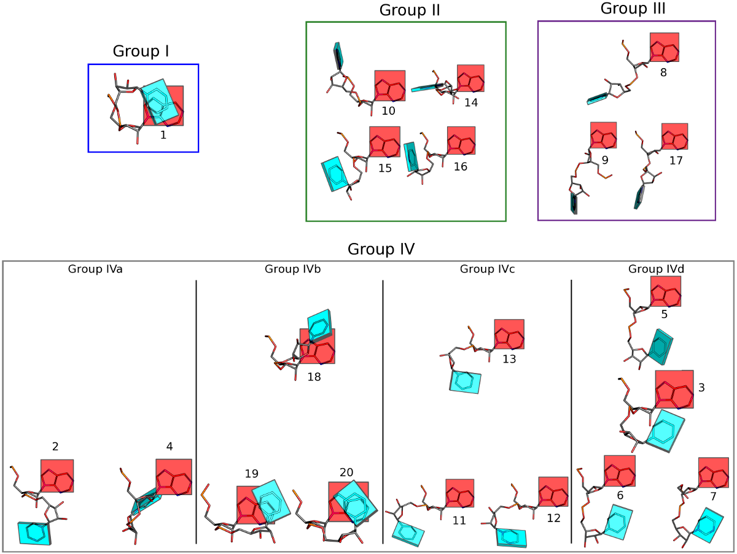
A-RNA

Slide 15
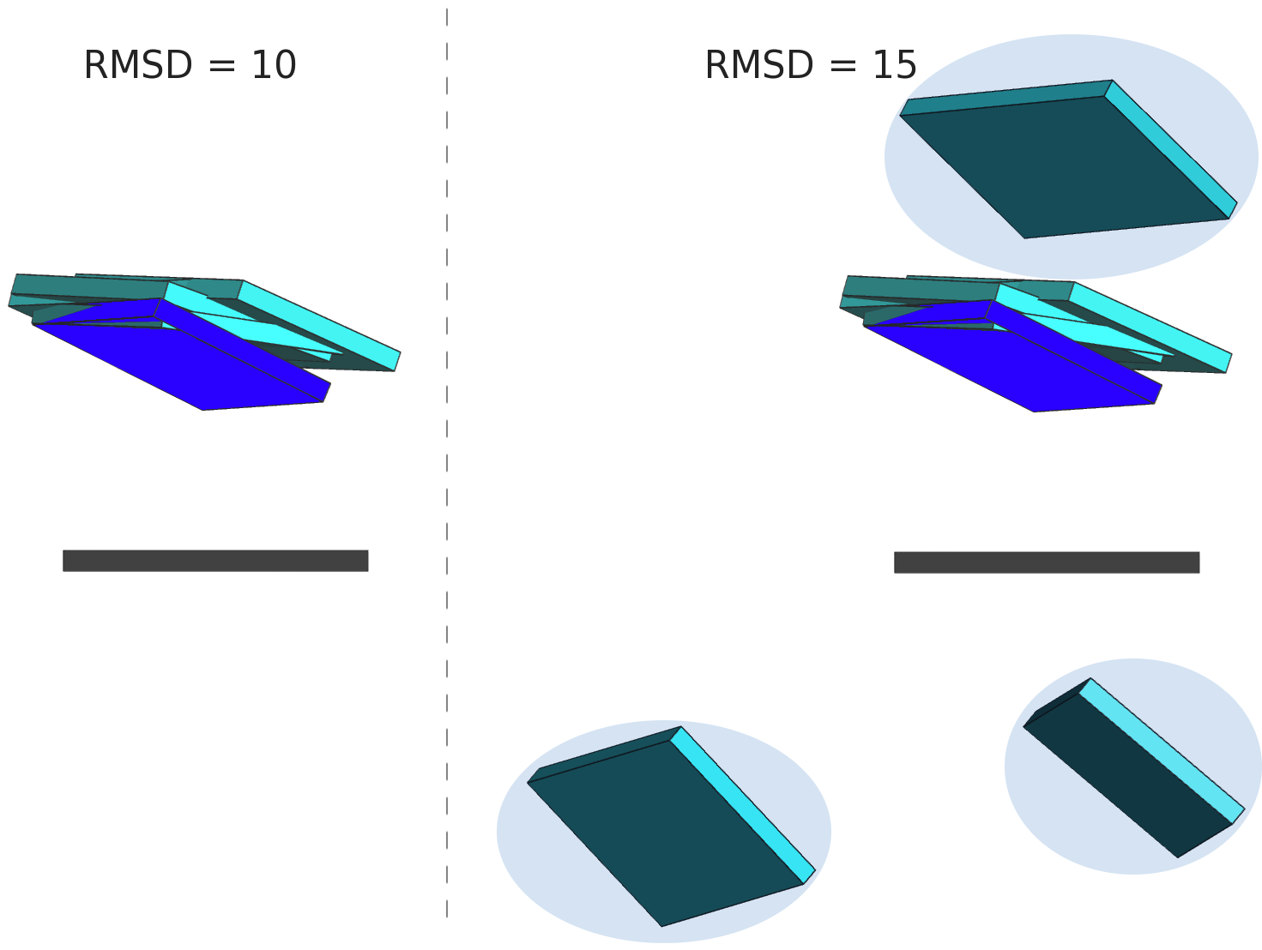
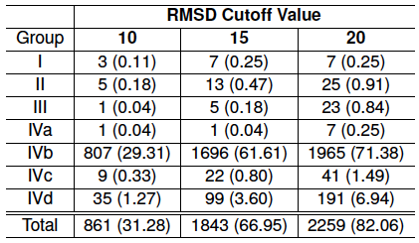
BASE STEPS Only a small fraction ~ 30 % of dinucleotide step conformations are represented in the ribosome.
In parentheses percentages of
confomer groups found in the 23S
subunit of the ribosome, PDB_ID: 1JJ2
Notes:
Subscript what’s in parentheses.

Slide 16
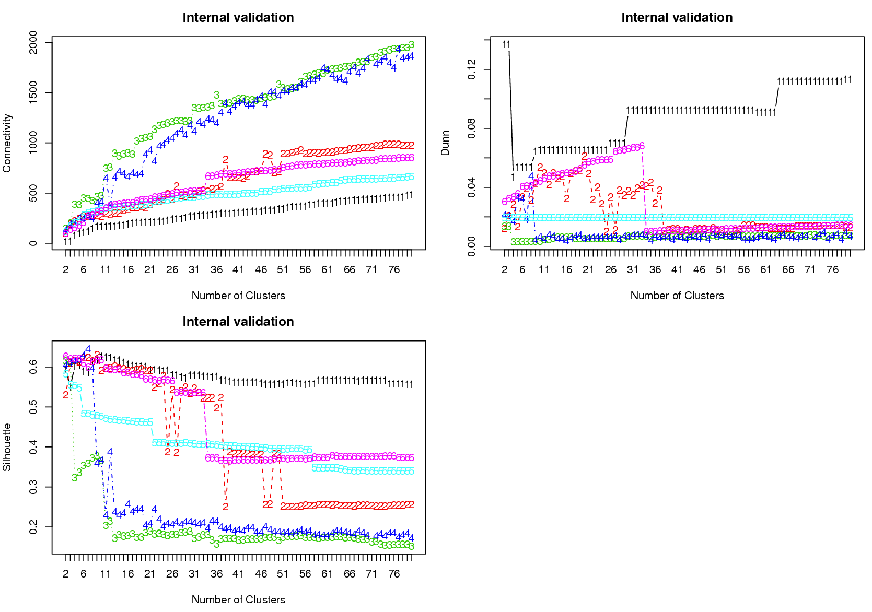
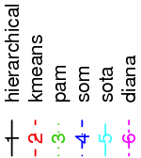
BASE STEPS Instead of picking any clustering methodology we use the clValid R package for cluster validation.
Just leave graph for Dunn Index.
Mention that the full method uses different scores.
Make sure to explain scores in previous slides.
SAVE IN THE BACK FULL PLOTS
Clustering methods
Clustering scores
Connectivity small
Silhouette large
Dunn Index large
Acronym in caps
No acronym
Notes:
Put in notes what the acronym.

Slide 17
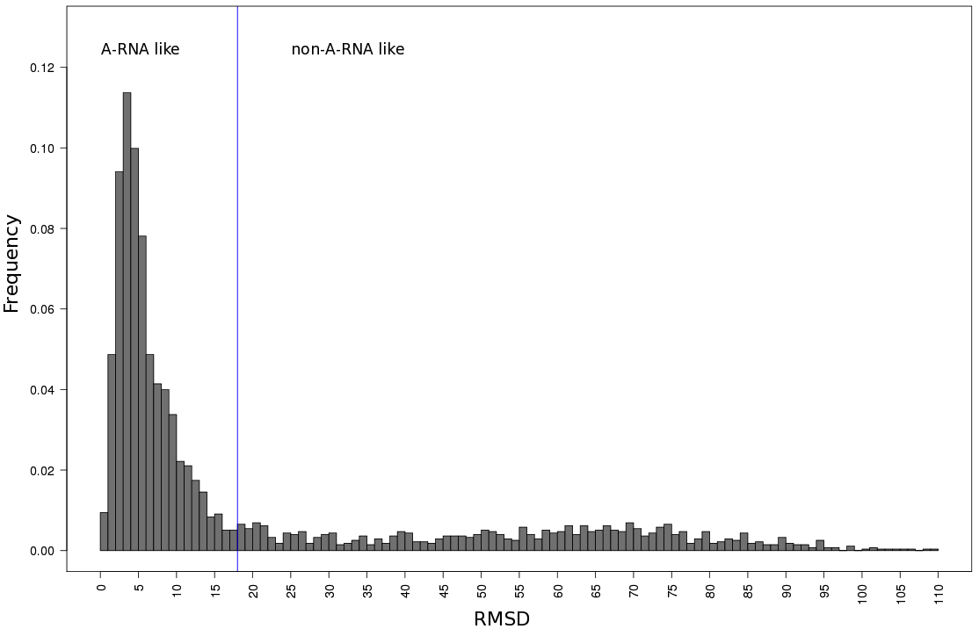
BASE STEPS Selecting A-RNA and non-ARNA-like datasets using distance to canonical ARNA parameters.
71% (1956)
29% (797)

Slide 18
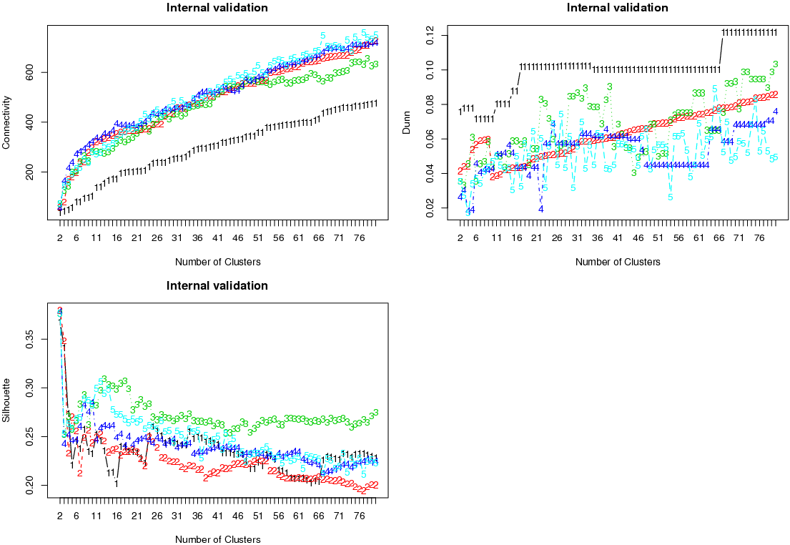
BASE STEPS For the non-A-RNA-like dinucleotide steps the best clustering method is the hierarchical one. k =67.
Connectivity small
Silhouette small
Dunn Index large
Notes:
Make sign at k=67
Make labels clearer
Make label of score trends better when.

Slide 19
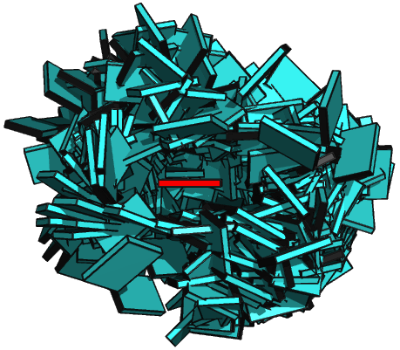
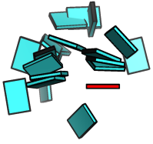

BASE STEPS Non-ARNA-like torsion angle conformers do not fill the full space of base geometries.
A-RNA
17 non-A-RNA-like
All non-ARNA
Notes:
Type what are all the groups.
Show the 67 I get, as averages and show that they fill the space better.
Show picture of all.
How many in all non-ARNA

Slide 20
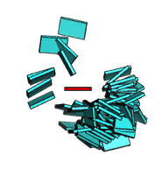
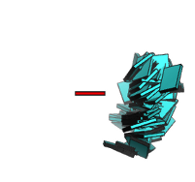
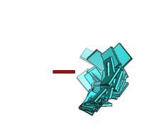
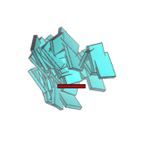
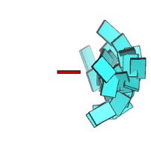
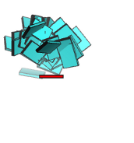
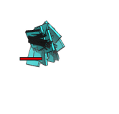
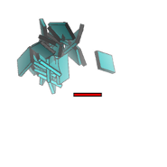
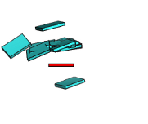
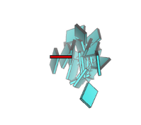
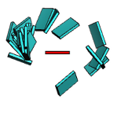
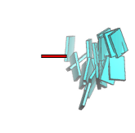
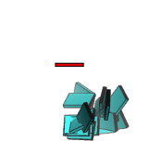
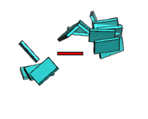
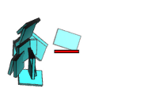
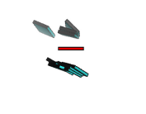
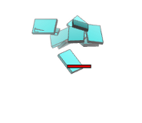
BASE STEPS There are 17 Main Non-ARNA-Like Clusters with ten or more members in them.
Numbers and percentages
Notes:
Include percentages of each group in non-ARNA.
What are the missing groups?
How many do 17 represent, the percent.

Slide 21
ACT II
Base-pairs in RNA helical regions

Slide 22
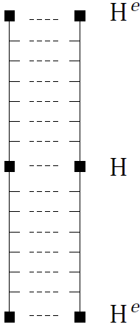
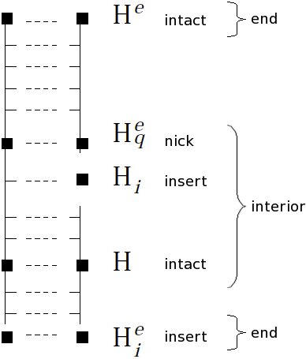
BASE PAIRS Helical regions in 3DNA can be continuous and quasi-continuous.
Get rid of the H’s
And just use continuous
And quasi-continuous.
Notes:
Picture of helical regions in 3D, quasi continuous vs continuous.
Base-pairing preferences, base-sequence preferences, which can be linked to tertiary interactions.

Slide 23
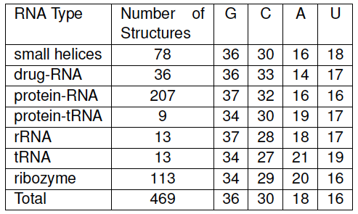
BASE PAIRS Partially non-redundant RNA dataset is GC rich.
Change table to have percent composition in row
Helices composed of 3 base-pairs or more
Notes:
MESSAGE HERE THAT ITS GC RICH

Slide 24
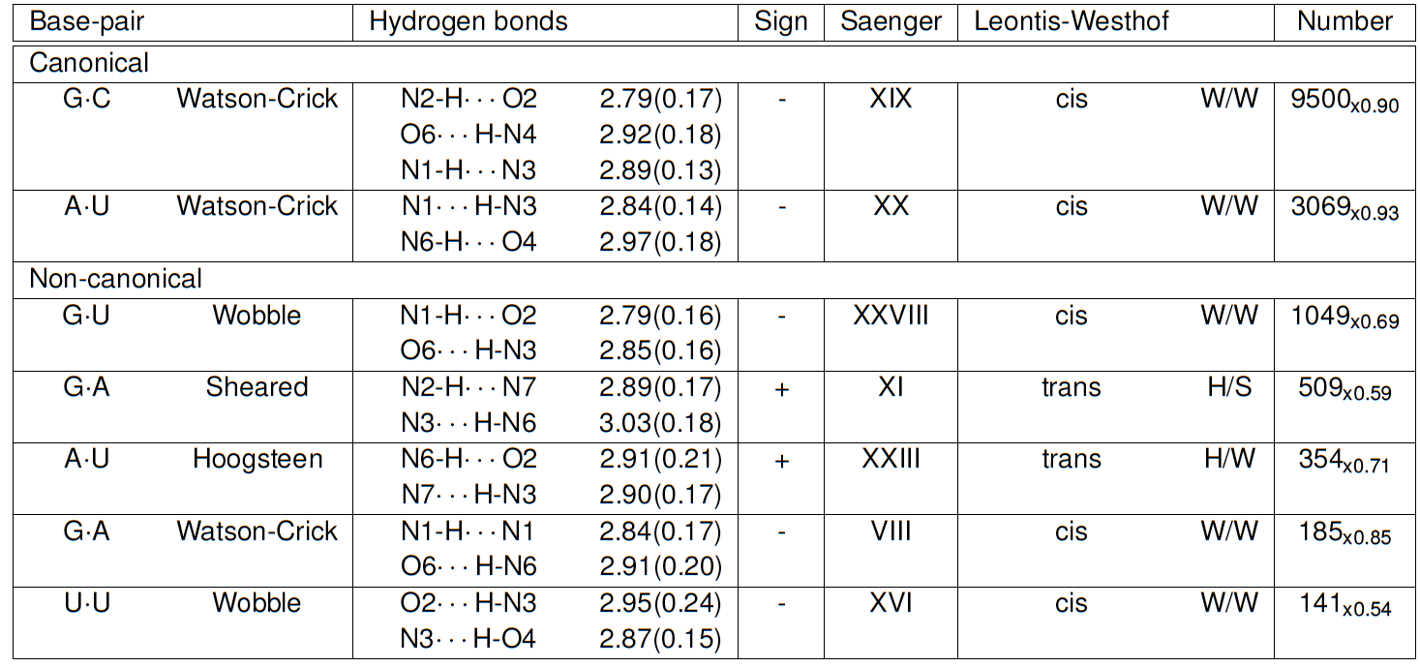
BASE PAIRS Seven predominant base-pairs in RNA helical regions make up to 90% of all base-pairs.
Explain subscripted values and standard dev, etc.
Get rid of sign
Get rid of L-W

Slide 25
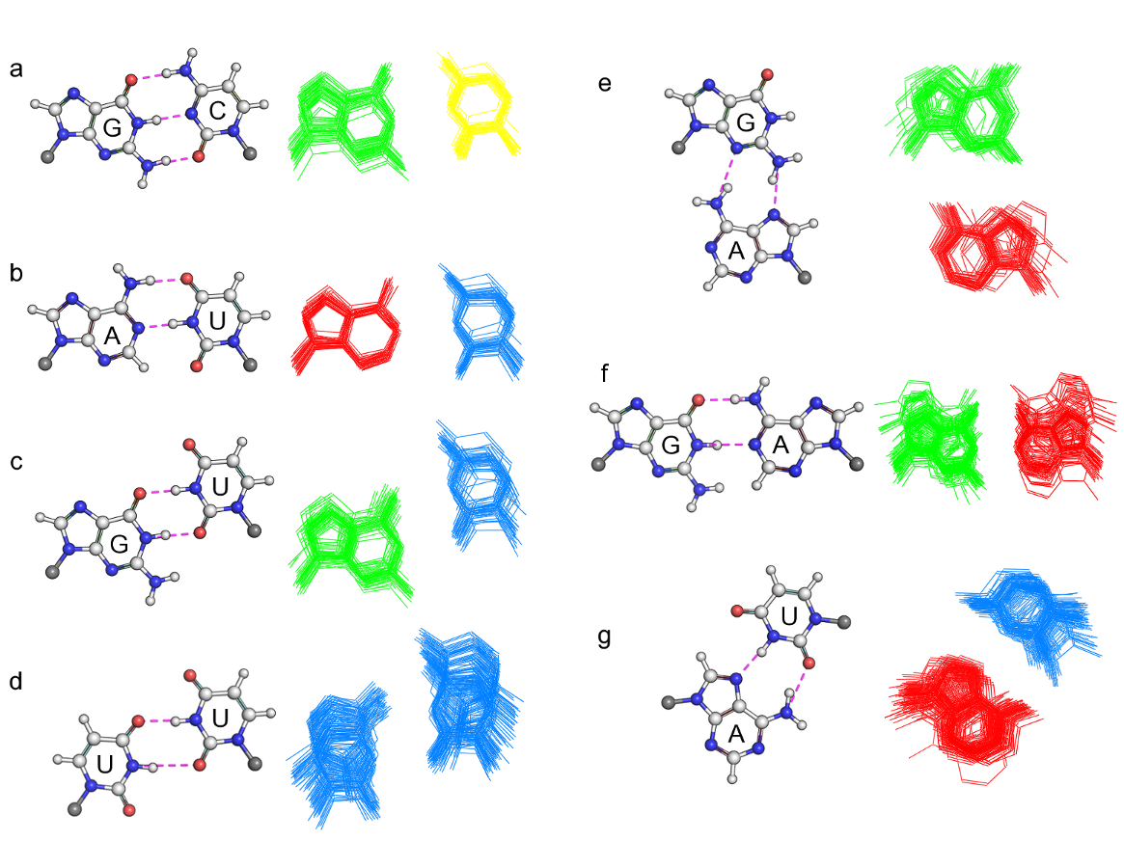
BASE PAIRS Non-canonical base-pairs are more deformable than canonical base-pairs.
Notes:
Use word volume but don’t explain that it’s product of eigenvalues.

Slide 26
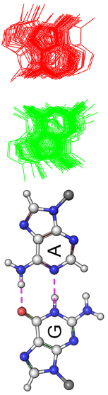

BASE PAIRS Most deformed base-pairs seem as oversized or undersized pieces in a puzzle.

Slide 27
ACT III
Base-pair-steps in RNA helical regions and RNA global properties

Slide 28

BASE PAIR STEPS RNA base-pair-steps in helical regions are still few when non-canonicals are considered.
Say what this table shows.
Not all possible combinations of base-pairs into base-pair steps
Are found in the studied helical regions.
Sheared G.A and U.Uw stand-out.
Make bp /bpi bigger
Get rid of overlaps

Slide 29
BASE PAIR STEPS RNA base-pair-steps parameters in helical regions and energy contours. The rnasteps website.
http://rnasteps.rutgers.edu

Slide 30
Intermezzo

Slide 31
BASE PAIR STEPS – GLOBAL Knowledge of adjacent base-pair steps makes it possible to make up a larger polymer.
Picture with four–five steps, just to illustrate principle. ala atsushi.
Show that persistence length is not isotropic
Appendix descriptions of persistence length.
Maybe pictures making sense of component of projection definition.

Slide 32

BASE PAIR STEPS – GLOBAL RNA sequence has subtle effects on the structure of RNA
Make them bigger.
Maybe not all.
Homopolymers and
block copolymers

Slide 33
BASE PAIR STEPS – GLOBAL
Movie or graph to explain persistence length
Talk about bending rigidity.
Table of different polymers and their persistence lengths.

Slide 34

BASE PAIR STEPS – GLOBAL There might be sequence dependence on the persistence length.
Make clearer the difference of
Symbols which superimpose
Add constants of Hagerman
And others

Slide 35

BASE PAIR STEPS – GLOBAL Surprisingly some RNA polymeric chains appear to be curved.
Notes:
FIX GRAPH

Slide 36

BASE PAIR STEPS – GLOBAL poly r(AC)₃ • poly r(GU)₃

Slide 37

BASE PAIR STEPS – GLOBAL Modelled vs. Experimental a In range with Hagerman, higher than Abels et al.
Reduce table to
Experimental and modelled values.
Persistence length derived from
X-ray structure analysis suggests
that RNA is stiffer than DNA and
in the range of Hagerman but
slightly higher than Abels and Dekker.

Slide 38
ACT IV
Finding RNA structural motifs using base step parameters.

Slide 39

IV. RNA STRUCTURAL MOTIFS getMotif: A simple program to find RNA motifs based on single stranded base step parameters.
getMotif uses a seed of single-stranded
base step parameters to apply a sliding
window technique to localize RNA
structural motifs in any RNA structure
given in pdb format.

Slide 40



RNA STRUCTURAL MOTIFS Testing the getMotif program using the GNRA Tetraloop Motif
GNRA tetraloop provides
good “toy” model to test getMotif
The first step in GNRA is quite far
from canonical A-RNA. NR, and RA
Steps are closer save for having
Greater slide and being over-twisted.
Change X to elements xij

Slide 41

RNA STRUCTURAL MOTIFS Sum of differences score for a sliding window finds potential GNRA tetraloop motif candidates.
Sum of difference score for the large
subunuit of the ribosome,
PDB_ID:1FFK, compared to the
GNRA tetraloops base steps.
Notes:
Make a sliding windows image.
An image with matrices in color which slides, remember Manju Bansal’s slides and Dr. Olson’s suggestion.

Slide 42

RNA STRUCTURAL MOTIFS The sum of differences score between single stranded base steps recognizes two GNRA groups.
Group II
Group I
GNRA recognizes two GNRA-like
motifs.
In blue the “canonical” GNRA tetraloop
motif. In red the lonepair triloop motif.
Move canonical in blue to left
Add base in pentaloops and
Tell how many in other slide

Slide 43

RNA STRUCTURAL MOTIFS Group II candidate is the lone-pair triloop motif, or a composite GNRA motif.
The GNRA-like candidates
apparently lacking the
G-A base-pair, form a lonepair
triloop motif, which is just a structural
GNRA motif, with a non-sequential
closing base-pair.
Notes:
Make sure that group II is tied to previous picture,

Slide 44
FINALE
The rigid body analysis reveals missing conformations on classification of RNA dinucleotide steps can be found using rigid-body parameters.
Base pairs in RNA helical regions in X-ray structures arrange in seven predominant types.
Modeling using rigid bodies gives surprising curving result.Rigid body parameters for the 10 Unique RNA base-pair steps formed from canonical base-pairs allow us to model polymer chains and compute the dependence of persistence length on chain lengths.
A new software for finding RNA motifs based on rigid-body parameters successfully finds the GNRA motifs add lone-pair triloops phrase
Notes:
Add conclusions to each act.
Future, open questions, coming attractions.
Passive voice.

Slide 45
FINALE Future and developing work.
Expand RNAsteps.rutgers.edu to periodically synchronize its data with the PDB in an automated fashion.
Construction of a dataset of base-step parameters for known RNA motifs to be used in the getMotif software.
Migrating the getMotif fully to python.
Develop a web-based front end to getMotif.
Notes:
Add conclusions to each act.
Future, open questions, coming attractions.

Slide 46

Thanks to my defense committee members for making it easy to schedule
this defense and your valuable time.
Special thanks to all members of the Olson Lab,
past and present.
Thanks to all for your attention,
Visit us at: http://dnaserver.rutgers.edu

Slide 47


Slide 48

BASE PAIR STEPS Energy contours on data culled by three standard deviations from the mean.
Notes:
This will just go from going into the website.

Slide 49
RNA STRUCTURAL MOTIFS Sum of differences score for a sliding window finds potential GNRA tetraloop motif candidates.
This is for 1FFK
Sliding windows image
Image with matrices in color
Boxes
e.g.
--- ---- ----
---- ---- -----
--- ---- ----
Notes:
Make a sliding windows image.
An image with matrices in color which slides, remember Manju Bansal’s slides and Dr. Olson’s suggestion.

Slide 50


